Slide 1
Lesson 2.2
jQuery Methods, Events and Effects

Slide 2
Learning Outcomes
Use jQuery selectors, events, methods and effects

Slide 3
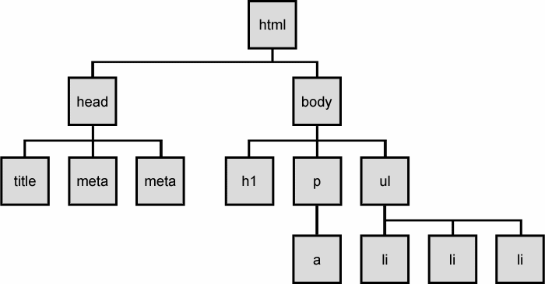
jQuery and the DOM
Identification: how do I obtain a reference to the node that I want?
Traversal: how do I move around the DOM tree?
Node Manipulation: how do I get or set aspects of a DOM node?
Tree Manipulation: how do I change the structure of the page?

Slide 4
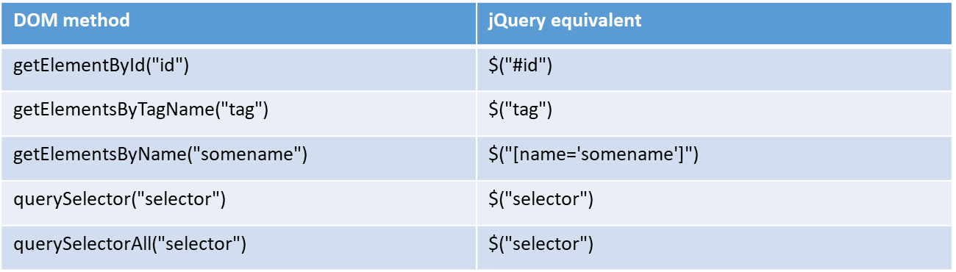
jQuery / DOM Selector Comparison

Slide 5
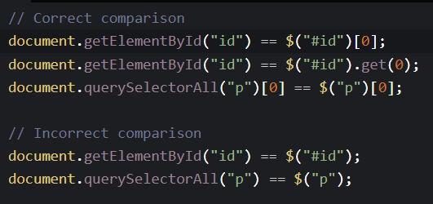
The jQuery Object
The $ function always returns an array of elements, even if it only finds a single match. This is called the jQuery object.
The jQuery object wraps the originally selected DOM objects.
You can access the actual DOM object by accessing the elements of the jQuery object.

Slide 6
jQuery HTML
jQuery contains powerful methods for changing and manipulating HTML elements and attributes.
Get methods allow you to get content from the DOM using jQuery.
Set methods allow you to set content to the DOM using jQuery.
Common get/set methods:
.text() – Sets or returns the text content of selected elements.
.html() – Sets or returns the content of selected elements (including HTML markup).
.val() – Sets or returns the value of form fields.
.attr() – Sets or returns attribute values.
.prop() – Sets or returns the value of specified properties of selected elements.
Example: https://codepen.io/michael-dorsey/pen/BabGbGB

Slide 7
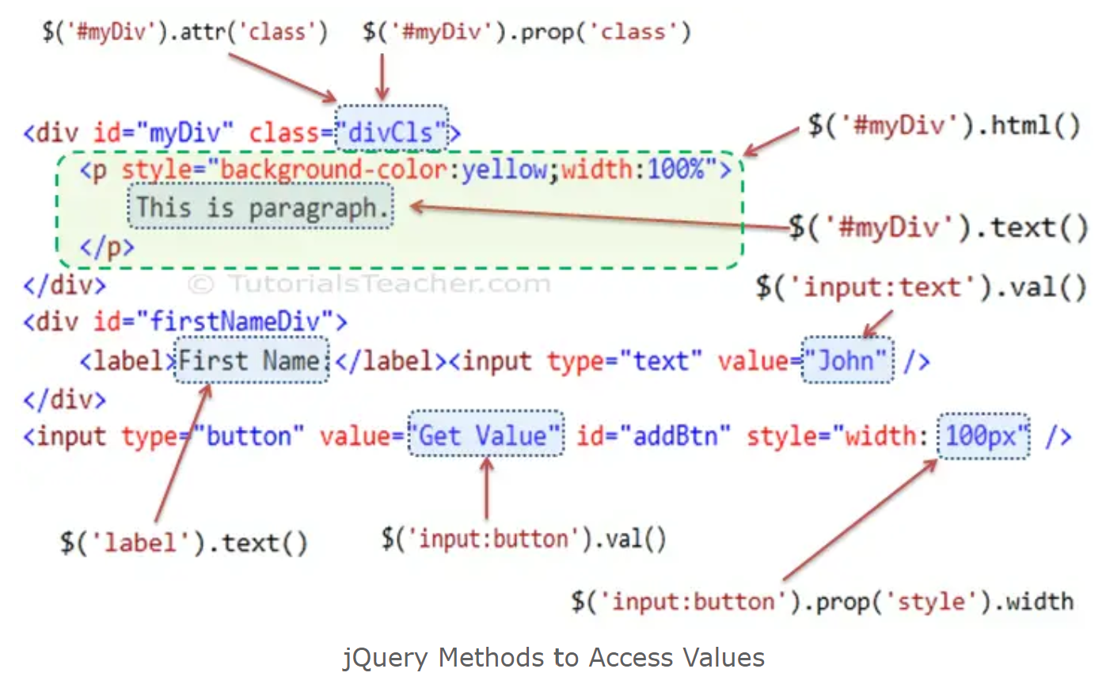

Slide 8
jQuery HTML
With jQuery you can easily add new elements to the DOM, and remove existing elements from the DOM.
Common add/remove methods:
.append() – Inserts content at the end of the selected elements.
.prepend() – Inserts content at the beginning of the selected elements.
.after() – Inserts content after the selected elements.
.before() – Inserts content before the selected elements.
.remove() – Removes the selected element (and its child elements).
.empty() – Removes the child elements from the selected element.
Example: https://codepen.io/michael-dorsey/pen/eYXQoWM

Slide 9
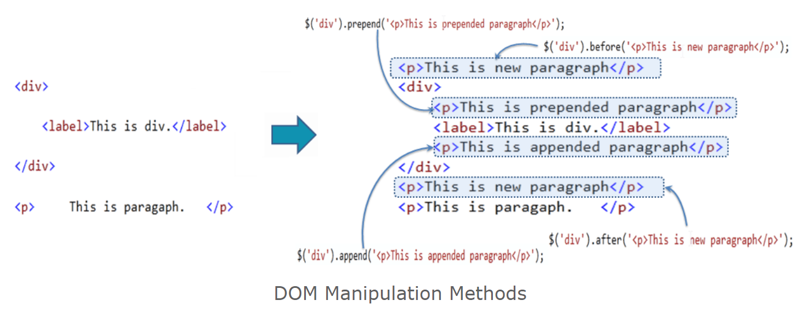
jQuery HTML
Difference between before(), after(), prepend(), and append()

Slide 10
jQuery CSS
With jQuery it is easy to manipulate the style of elements.
Common methods for CSS manipulation:
.addClass() – Adds one or more classes to the selected elements.
.removeClass() – Removes one or more classes from the selected elements.
.toggleClass() – Toggles between adding/removing classes from the selected elements.
.css() – Sets or returns the style attribute.
Example: https://codepen.io/michael-dorsey/pen/yLwQWwm

Slide 11
jQuery Dimensions
With jQuery it is easy to work with the dimensions of elements and the browser window.
Common methods for working with dimensions:
.width() – Sets or returns the width of an element (excludes padding, border and margin).
.height() – Sets or returns the height of an element (excludes padding, border and margin).
.innerWidth() – Returns the width of an element (includes padding).
.innerHeight() – Returns the height of an element (includes padding).
.outerWidth() – Returns the width of an element (includes padding and border).
.outerHeight() – Returns the height of an element (includes padding and border).
.outerWidth(true) – Returns the width of an element (includes padding, border, and margin).
.outerHeight(true) – Returns the height of an element (includes padding, border, and margin).

Slide 12
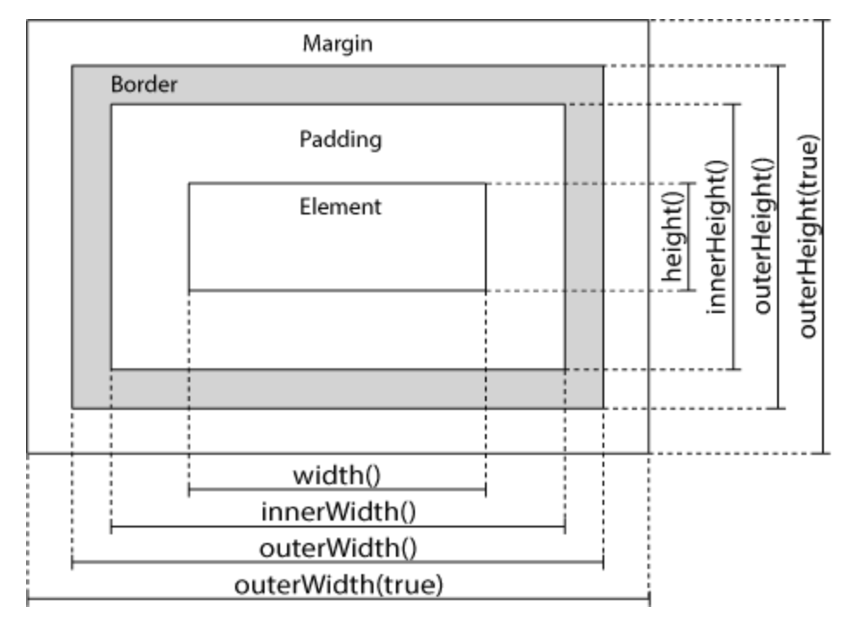

Slide 13
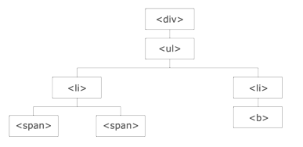
jQuery Traversing
jQuery traversing is the act of moving through HTML elements to find or select a specific one, based on their relationship to other elements.
Start with one selection and move through that selection until you reach the element(s) you desire.
Move up to an element’s ancestors.
Move down to an element’s descendants.
Move sideways to an element’s siblings.
Notes:
The <div> element is the parent of <ul>, and an ancestor of everything inside of it
The <ul> element is the parent of both <li> elements, and a child of <div>
The left <li> element is the parent of <span>, child of <ul> and a descendant of <div>
The <span> element is a child of the left <li> and a descendant of <ul> and <div>
The two <li> elements are siblings (they share the same parent)
The right <li> element is the parent of <b>, child of <ul> and a descendant of <div>
The <b> element is a child of the right <li> and a descendant of <ul> and <div>

Slide 14
jQuery Traversing
jQuery provides many methods for traversing the DOM.
Traversing UP the DOM tree:
.parent() – Returns the direct parent element of the selected element (one level).
.parents() –Returns all ancestor elements of the selected element, all the way up to the document's root element.
Traversing DOWN the DOM tree:
.children() – Returns all direct children of the selected element (one level).
.find() – Returns descendant elements of the selected element, all the way down to the last descendant.
Traversing SIDEWAYS in the DOM tree:
.siblings() – Returns all sibling elements of the selected element.
.next() – Returns the next sibling element of the selected element.
.nextAll() – Returns all next sibling elements of the selected element.
.prev() – Returns the previous sibling element of the selected element.
.prevAll() – Returns all previous sibling elements of the selected element.

Slide 15
jQuery Traversing
Filtering through the DOM tree:
.first() – Returns the first element of the specified elements.
.last() – Returns the last element of the specified elements.
.filter() – Lets you specify a criteria. Elements that do not match the criteria are removed from the selection, and those that match will be returned.
.each() – Iterate over specified elements and execute specified callback function for each element.
Example: https://codepen.io/michael-dorsey/pen/RwdEjaQ

Slide 16
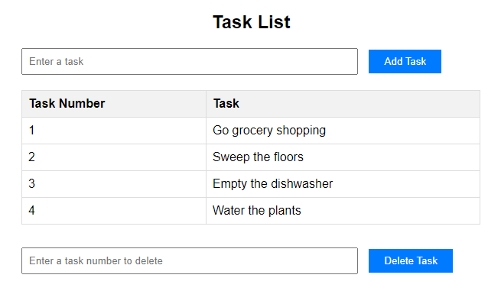
Practice Activity
Build a Task List application whereby…
Users can add tasks to a table by enter the task’s text.
Users can delete tasks from the table by entering the task number to be deleted.
Instructions:
Download the “TaskList-Starter.zip” file from D2L > Class Resources and extract the three files.
“index.html” and “styles.css” are complete. You don’t need to modify them.
“script.js” includes functions for adding a task and deleting a task.
Write the code to add a task to the table. Verify that the user entered text and clear the textbox afterwards.
Stretch activity: write the code to delete a task from the table corresponding with the task number entered.

Slide 17
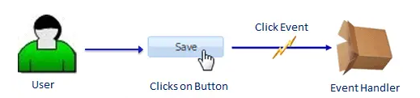
jQuery Events
What are events?
User actions that a web page can respond to are called events.
An event represents the precise moment when something happens.
We often use the term “fires” or “fired” when an event occurs.
Examples:
Moving a mouse over an element.
Clicking a button.
Typing on a keyboard into a textbox.

Slide 18
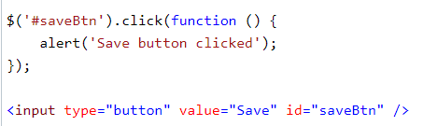
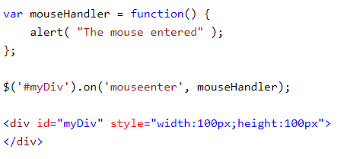
jQuery Events
jQuery is great for responding to events. Most DOM events have an equivalent jQuery method.
How to use events in jQuery?
Use the selector to get the reference of an element.
Call jQuery event methods to fire it or attach an event handler. An event handler is a function that will be executed when an event fires.
Use the this keyword to access the DOM element that raised the event.

Slide 19
jQuery Events
Common event methods. Each method will attach an event handler function to an HTML element.
.click() – Attached function executes when the user clicks on the HTML element.
.mouseenter() – Attached function executes when the mouse pointer enters the HTML element.
.mouseleave() – Attached function executes when the mouse pointer leaves the HTML element.
.hover() – Combination of mouseenter() and mouseleave() methods.
.keypress() – Attached function executes when a keyboard key is pressed.
.submit() – Attached function executes when an HTML form is submitted.
.change() – Attached function executes when the value of an HTML form field has been changed.
.focus() – Attached function executes when an HTML form field gets focus.
.blur() – Attached function executes when an HTML form field loses focus.
.on() – Attaches one or more event handlers for the selected elements.
Example: https://codepen.io/michael-dorsey/pen/PoLrOJz

Slide 20
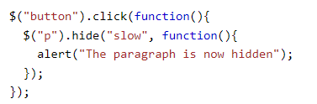
jQuery Effects
jQuery includes methods which give special effects to elements.
Effects can be useful in building an interactive user interface.
Effect methods can take a callback function which will be executed after the current effect is finished. This can help prevent display issues.

Slide 21
jQuery Effects
Hide and Show Effects:
.hide() – hide an element.
.show() – show an element.
.toggle() – toggle between hiding and showing an element.
Fading Effects:
.fadeIn() – fade in a hidden element.
.fadeOut() – fade out a visible element.
.fadeToggle() – toggle between fadeIn() and fadeOut() methods.
Sliding Effects:
.slideDown() – slide down an element.
.slideUp() – slide up an element.
.slideToggle() – toggle between slideDown() and slideUp() methods.

Slide 22
jQuery Effects
Animation Effects:
.animate() – perform custom animation using an element's style properties.
The animate() method changes existing style properties to the specified properties with motion.
Syntax:
{params} defines the CSS properties to be animated,
speed specifies the duration of the effect (“slow”, “fast”, or milliseconds),
callback is a function to be executed after the animation completes.
By default, all HTML elements have a static position, and cannot be moved. To manipulate the position, first set the CSS position property of the element to “relative”, “fixed”, or “absolute”.
Example: https://codepen.io/michael-dorsey/pen/rNREYPo

Slide 23
jQuery Chaining
With jQuery, you can chain together multiple actions to happen automatically in a specific order.
Chaining allows us to run multiple jQuery methods on the same element within a single statement.
To chain an action, you simply append the action to the previous action.
The element “p1” will change to red, then slide up for 2 seconds, then slide down for 2 seconds (in that order).
Example: https://codepen.io/michael-dorsey/pen/KKEOrxv

Slide 24
Micro-blog Example
https://codepen.io/michael-dorsey/pen/abgdMMM

Slide 25
Assessment Review
Quiz 1
GLA 1

Slide 26
For next class
Read Lesson 3.1 and do Learning Activities 3.1.1.
Read Lesson 3.2 and do Learning Activities 3.2.1, 3.2.2
Assessments Reminder:
Assignment 1 due July 25, 8:00am.
Group Project due August 22, 11:59pm.
All assessment dates have been posted in D2L.
See the “Assignments Policy” for late submission procedures.

Slide 27
References
https://www.w3schools.com/jquery/jquery_events.asp
https://www.tutorialsteacher.com/jquery/jquery-event
https://www.w3schools.com/jquery/jquery_callback.asp
https://www.w3schools.com/jquery/jquery_hide_show.asp
https://www.w3schools.com/jquery/jquery_fade.asp
https://www.w3schools.com/jquery/jquery_slide.asp
https://www.w3schools.com/jquery/jquery_animate.asp
https://www.w3schools.com/jquery/jquery_chaining.asp
https://www.w3schools.com/jquery/jquery_dom_get.asp
https://www.w3schools.com/jquery/jquery_dom_set.asp
https://www.w3schools.com/jquery/jquery_dom_remove.asp
https://www.w3schools.com/jquery/jquery_dom_add.asp
https://www.w3schools.com/jquery/jquery_css_classes.asp
https://www.tutorialsteacher.com/jquery/jquery-manipulate-attributes-of-dom-elements
https://www.tutorialsteacher.com/jquery/jquery-dom-manipulation
https://www.w3schools.com/jquery/jquery_dimensions.asp
https://www.w3schools.com/jquery/jquery_traversing.asp
https://www.tutorialsteacher.com/jquery/jquery-traversing-dom-elements

